Slide 1


Data Structures
#LifeKoKaroLift

Slide 2



Module Name- Stacks &
Queues
Class - Day 1
Topic Name: Stacks
EditEdit MasterMaster texttext stylesstyles

Slide 3
Time Allocation Summary
Element | Slide numbers | Maximum time(min)
Spot Test | 4-6 | 10
Today’s Agenda | 7 | 5
Data Structures | 8 - 11 | 15
Introduction to Stacks | 12 - 18 | 20
Total Time |  | 120

Slide 4
Spot Test
Let’s take a quick revision assessment of previously taught topics :-
Arrays and Array Lists
Linked Lists
Finding an element in array lists/linked lists
Inserting an element at arbitrary position in array lists/linked lists

Slide 5
Spot Test
We learnt that array lists and linked lists are both built on the core concept of lists. Then why to have two different data structures?
It is because even though they are implementation of a list, their structures are different and hence the time complexities of the same operation are different for both.
Do you remember what were the time complexities of finding an element, insertion/ deletion of elements(both at beginning and an arbitrary position)???

Slide 6
Spot Test
Time complexities of various operations on ArrayList and LinkedList:
Finding an element:
ArrayList: O(1)
LinkedList: O(N)
Insertion/Deletion at beginning:
ArrayList: O(N)
LinkedList: O(1)
Insertion/Deletion at arbitrary position:
ArrayList:O(N)
LinkedList:O(N)

Slide 7

Today’s Agenda
Data Structures
Introduction to Stack

Slide 8
Data Structures
So far we have dealt with many algorithms. An algorithm is a computational process which deals with data.
It can create, modify or delete data on execution.
Data arrangement is very important to make the algorithms work well as it does not only make the algorithm flexible and easy to modify, but can lead to significant changes in the efficiency of the algorithm.
This statement can be easily justified with the difference in speeds of the operations like reading an element or adding an element when the data is arranged as an Array List and when it is arranged as a Linked List.

Slide 9
Data Structures
A data structure is a specialized format for storing and processing data which provides us with an efficient way to use and modify our data.
For any data structure, we study about its:
Abstract Data Type( ADT) used
Functionalities
Internal Design
Applications

Slide 10
Data Structures
The terms data structures and Abstract Data Types are generally confused with each other, but they are not the same.
An abstract data type an be understood with an example of the list interface, which is not a data structure in itself but helps in the implementation of other data structures.
In more technical terms, an ADT is an entity which defines the capabilities of a data arrangement.
A data structure on the other hand is just the concrete implementation of these ADTs. Examples are Array Lists and Linked Lists.

Slide 11
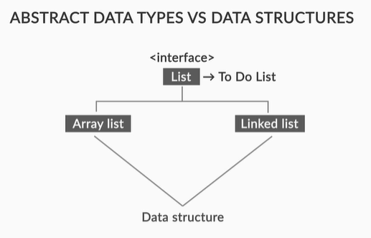
Data Structures
Taking this discussion to the Object Oriented environment, an Abstract Data Type, such as a list is best understood as an interface.
Data Structures like array lists and linked lists implement this interface.

Slide 12

Introduction to Stack
Generally, whenever we have to wait for something in a line, we are served first come first serve basis. For example, in clinics, billing counters, ATMs and government offices.

Slide 13

Introduction to Stack
Can you imagine a real life example where a line is resolved on last come first serve basis?
What if the professor decides to give a penalty based on how late the students arrive in the class?
You definitely don’t want to come last in that line.

Slide 14

Introduction to Stack
Now, consider a stack of books.
If you were to pick one random book from the stack, from which portion of it would you pick it?
From the top?
From the bottom?
Or from somewhere in between?
Any sane person would always pick up from the top.

Slide 15
Introduction to Stack
Trying to pull out a book from anywhere else in the stack would be possible, but would lead to difficulties, and untoward results.
In the same manner, if you were to add a book to this stack, where would you prefer to add it? Again, at the top, of course.

Slide 16

Introduction to Stack
Let’s take another example of an office employee.
He is peacefully doing his work when he gets assigned with an important task. He leaves his work and start working in this task 1.
Just as he is in the middle of task 1, he gets assigned another important task 2. He immediately switches to task 2 and he has just started working on it when he gets bombarded with another task 3 and he has to switch to the latest task now.
Clearly, the tasks are complete according to the Last In First Out principle.

Slide 17
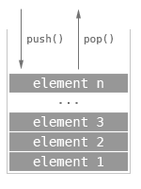
Introduction to Stack
This structure of books where you add things at the top and remove things again from the top is analogous to a data structure called “Stacks”.
In a stack, what goes in last is the first to come out.
This property of the above structure is called last in first out (or LIFO) order.

Slide 18

Introduction to Stack
A stack is therefore anything:
Into which you insert (push) and remove (pop) things from one end of it.
That follows LIFO rule.

Slide 19
Thank You!
#LifeKoKaroLift

